Slide 1
AGI WEEK-3 Presentation
Kadiri MOHAN KUMAR

Slide 2
Model
Input :- Neural signals
Output :- Corresponding Action
Technique :- Reinforcement Learning, Unsupervised Learning

Slide 3
Requirements
Unsupervised Learning
Reinforcement Learning

Slide 4
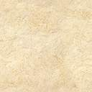
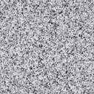
Over-view of Process
Reinforcement Learning
USL
Input
Action
Reward
Feedback

Slide 5
Data Computation:-
Input = neural signal in vector form
Preprocessing step includes PCA where the data is reduced to 2 dimensions
Returns Data Frame from preprocessing step
Get the optimized k value for clusters using elbow method where the optimized k is found through Elbow-method by plotting and identifying the elbow from the graph.
Form clusters based on k –value obtained by elbow method using k-means algorithm
If the no of clusters increased from past then new action learnt i.e., reward

Slide 6
Data Structures used:-
DataFrame :- to store the neural signals.
List :- used to store x and y co-ordinates while plotting the cluster.

Slide 7
code
Click here to view the code

Slide 8


